Slide 1
TEAM:TROJAN HORSES
Members:
Ameena Abubacker (245255)
Aysha C Rasheed (245245)
Haritha Hari (245205)
Aiswarya K (245182)

Slide 2
Contents
Queue
Dequeue
Priority Queue
Array Dequeue

Slide 3
QUEue

Slide 4
JAVA Queue INTERFACE
Collection in Java
linear data structure
elements of the same kind
First In, First Out- FIFO
import java.util.Queue package in order to use Queue

Slide 5
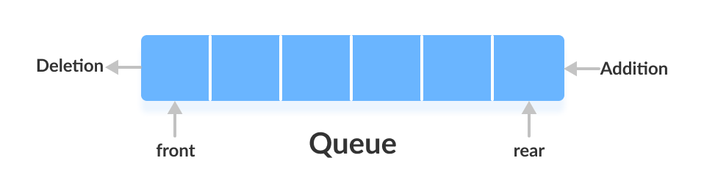
Two ends - Front and Rear
generic representation :
public interface Queue<T> extends Collection<T>

Slide 6
CREATING QUEUE OBJECTS
objects cannot be created of the type queue. We always need a class which extends this list in order to create an object.
// Obj is the type of the object to be stored in Queue
Queue<Obj> queue = new PriorityQueue<Obj> ();
Queue<Obj>queue = new LinkedList<>();
Queue<Obj>queue = new ArrayDeque<>();

Slide 7
METHODS OF QUEUE
add() - Inserts the specified element into the queue. If the task is successful, returns true if not it throws an exception
element() - Returns the head of the queue. Throws an exception if the queue is empty
poll() - Removes the head of the queue and returns it. If the queue is empty, it returns null
size() - Returns the size or number of elements in the queue

Slide 8
Offer() - Insert the new element e into the queue without violating capacity restrictions
peek() - Returns the head of the queue. Returns null if the queue is empty
remove() - Returns and removes the head of the queue. Throws an exception if the queue is empty

Slide 9
OPERATIONS ON QUEUE INTERFACE
Adding Elements - add() method
Removing Elements - remove() method
Iterating the Queue - queue has an inbuilt iterator which can be used to iterate through the queue

Slide 10
JAVA QUEUE ARRAY IMPLEMENTATION
Operations performed :
Enqueue - To insert an element
For inserting an element at the rear end, we first need to check if the queue is full. If it is full, then we cannot insert the element. If rear < n, then we insert the element in the queue
Dequeue - To delete an element

Slide 11
First, we check whether the queue is empty. For dequeue operation to work, there has to be at least one element in the queue
Front - This method returns the front of the queue.
Display -This method traverses the queue and displays the elements of the queue

Slide 12
Applications of Queue
Multi programming
Network
Job Scheduling
Shared resources

Slide 13
Advantages of Queue
large amount of data can be managed efficiently with ease
Operations such as insertion and deletion can be performed with ease
useful when a particular service is used by multiple consumers.
fast in speed for data inter-process communication.
used in the implementation of other data structures.

Slide 14
Disadvantages of Queue
The operations such as insertion and deletion of elements from the middle are time consuming.
Limited Space.
Searching an element takes O(N) time.
Maximum size of a queue must be defined
prior

Slide 15
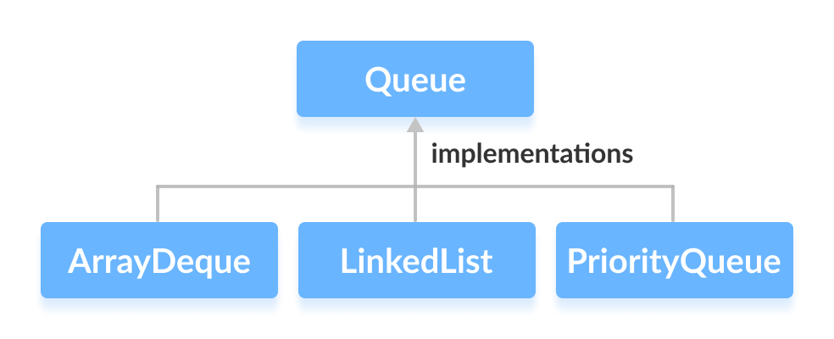
CLASSES THAT IMPLEMENTS QUEUE
Cannot provide direct implementation, need to use classes that implement it:

Slide 16
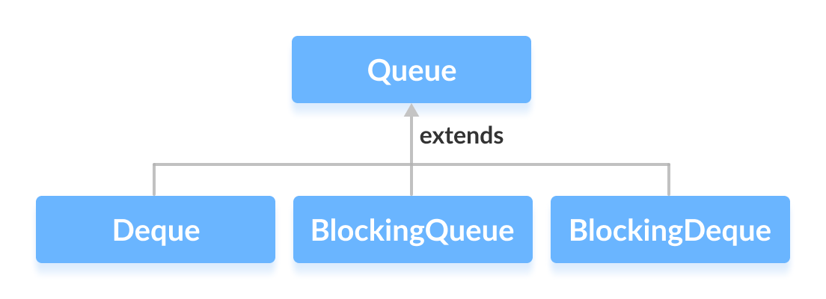
Interfaces that extends queue

Slide 17
DEQUE

Slide 18
Subtype of the queue interface.
Double-ended queue that supports the addition or removal of elements.
Used as a queue(FIFO) and stack(LIFO).
Part of the Java Collections Framework - to provide a generic and flexible data structure.
How to use Deque java.Util.Deque package to use deque

Slide 19
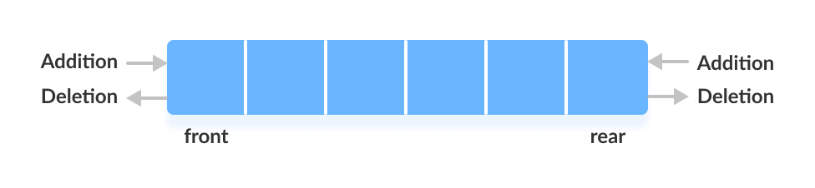
Working of deque
Working of Deque
Queue - elements are added from the rear and removed from the front.
Deque - insert and remove elements from both front and rear.

Slide 20
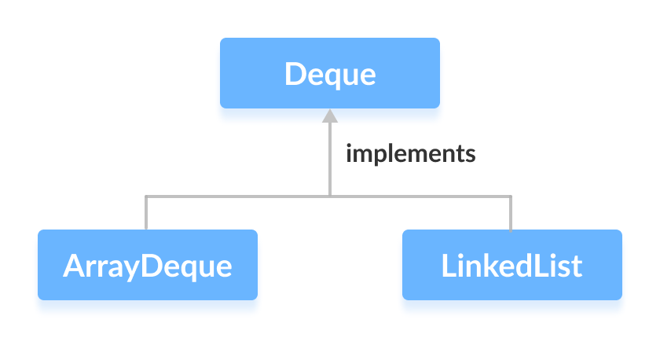
SYNTAX
Public interface Deque extends Queue
// LinkedList implementation of Deque
Deque<String> animal2 = new LinkedList<>();
// Array implementation of Deque
Deque<String> animal1 = new ArrayDeque<>();

Slide 21
Methods of Deque
Since Deque extends the Queue interface, it inherits all the methods of the Queue interface.
addFirst() - Adds the specified element at the beginning of the deque. Throws exception if full.
addLast() - Adds the specified element at the end of the deque. Throws exception if full.
offerFirst() - Adds the specified element at the beginning of the deque. Returns false if full.
offerLast() - Adds the specified element at the end of the deque. Returns false if full.
getFirst() - Returns the first element of the deque. Throws exception if empty.
getLast() - Returns the last element of the deque. Throws exception if empty.

Slide 22
peekFirst() - Returns the first element of the deque. Returns null if the deque is empty.
peekLast() - Returns the last element of the deque. Returns null if the deque is empty.
removeFirst() - Returns and removes the first element of the deque. Throws an exception if the deque is empty.
removeLast() - Returns and removes the last element of the deque. Throws an exception if the deque is empty.
pollFirst() - Returns and removes the first element of the deque. Returns null if the deque is empty.
pollLast() - Returns and removes the last element of the deque. Returns null if the deque is empty.

Slide 23
Deque as Stack Data Structure
Java Collections framework provides the implementation of the stack.
Recommended to use Deque as a stack instead of the Stack class. It is because methods of Stack are synchronized.
Here are the methods the Deque interface provides to implement stack:
push() - adds an element at the beginning of deque
pop() - removes an element from the beginning of deque
peek() - returns an element from the beginning of deque

Slide 24
Operations on Deque
size(): Determining the number of elements in the deque.
clear(): Remove all the elements from the deque. It leaves the deque with a size of 0.
swap(): Swap the contents of one deque with another deque.
resize(): Change the number of elements in the deque to a specific number.
getRear(): Gets the last item from queue.
isEmpty(): Checks whether Deque is empty or not.
isFull(): Checks whether Deque is full or not.

Slide 25
assign(): Assign new values to the elements in the deque.
reverse(): Reverse the order of the elements in the deque.
sort(): Sort the elements in the deque in ascending order.
insertFront(): Adds an item at the front of Deque.
insertLast(): Adds an item at the rear of Deque.
deleteFront(): Deletes an item from the front of Deque.
deleteLast(): Deletes an item from the rear of Deque.
getFront(): Gets the front item from the queue.

Slide 26
Advantages
Double-Ended:
Allows elements to be added and removed from both ends of the queue.
Good choice for scenarios where you need to insert or remove elements at both the front and end of the queue.
Flexibility:
Provides a number of methods for adding, removing, and retrieving elements from both ends of the queue.
Blocking Operations:
takeFirst and takeLast allows to wait for elements to become available or for space to become available in the queue.
Good choice for concurrent and multithreaded applications.

Slide 27
disadvantages
Performance:
Can be slower than other data structures, such as a linked list or an array, because it provides more functionality.
Implementation Dependent:
The behavior of a Deque can depend on the implementation you use.
For example, some implementations may provide thread-safe operations, while others may not.
It’s important to choose an appropriate implementation and understand its behavior before using a Deque.

Slide 28
applications
Applied as both stack and queue, as it supports both operations.
Storing a web browser’s history.
Storing a software Application's list of undo operation
Job Scheduling Algorithms.
Palindrome checking
Graph traversal
Task scheduler

Slide 29
Priority queue

Slide 30
A priority queue is a type of queue that arranges elements based on their priority values. Elements with higher priority values are typically retrieved before elements with lower priority values.
It is known that a Queue follows the First-In-First-Out algorithm
PriorityQueue is based on the priority heap. The elements of the priority queue are ordered according to the natural ordering, or by a Comparator provided at queue construction time

Slide 31
Properties of Priority Queue
PriorityQueue doesn’t permit null.
Every item has a priority associated with it.
The queue retrieval operations poll, remove, peek, and element access the element at the head of the queue.
It provides O(log(n)) time for add and poll methods.

Slide 32
How is Priority assigned to the elements in a Priority Queue?
In a priority queue, generally, the value of an element is considered for assigning the priority.
For example, the element with the highest value is assigned the highest priority and the element with the lowest value is assigned the lowest priority. The reverse case can also be used.

Slide 33
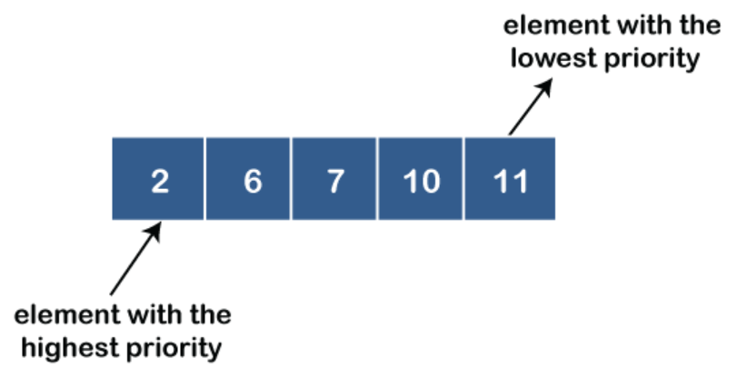
Types of Priority Queue
Ascending order priority queue: In ascending order priority queue, a lower priority number is given as a higher priority in a priority.
For example, we take the numbers from 1 to 5 arranged in an ascending order like 1,2,3,4,5; therefore, the smallest number, i.e., 1 is given as the highest priority in a priority queue

Slide 34
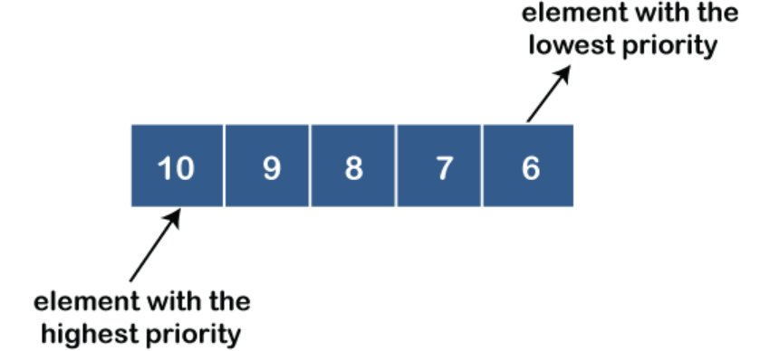
Descending order priority queue: In descending order priority queue, a higher priority number is given as a higher priority in a priority. For example, we take the numbers from 1 to 5 arranged in descending order like 5, 4, 3, 2, 1; therefore, the largest number, i.e., 5 is given as the highest priority in a priority queue.

Slide 35
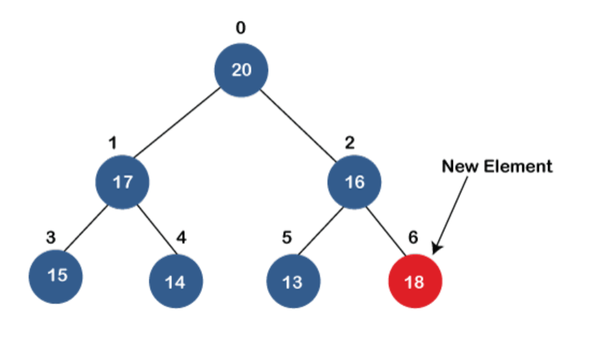
Operations of a Priority Queue:
1. Adding Elements: In order to add an element in a priority queue, we can use the add() method. The insertion order is not retained in the PriorityQueue. The elements are stored based on the priority order which is ascending by default.

Slide 36
2. Removing Elements: In order to remove an element from a priority queue, we can use the remove() method. If there are multiple such objects, then the first occurrence of the object is removed. Apart from that, the poll() method is also used to remove the head and return it.

Slide 37
3. Accessing the elements: Since Queue follows the First In First Out principle, we can access only the head of the queue. To access elements from a priority queue, we can use the peek() method.

Slide 38
4. Iterating the PriorityQueue: There are multiple ways to iterate through the PriorityQueue. The most famous way is converting the queue to the array and traversing using the for loop. However, the queue also has an inbuilt iterator which can be used to iterate through the queue.

Slide 39
Constructors:
PriorityQueue():Creates a PriorityQueue with the default initial capacity (11) that orders its elements according to their natural ordering.
PriorityQueue(Collection<E> c): Creates a PriorityQueue containing the elements in the specified collection

Slide 40
3.PriorityQueue(int initialCapacity): Creates a PriorityQueue with the specified initial capacity that orders its elements according to their natural ordering.
4. PriorityQueue(int initialCapacity, Comparator<E> comparator): Creates a PriorityQueue with the specified initial capacity that orders its elements according to the specified comparator.
5. PriorityQueue(PriorityQueue<E> c): Creates a PriorityQueue containing the elements in the specified priority queue.
6. PriorityQueue(SortedSet<E> c): Creates a PriorityQueue containing the elements in the specified sorted set.

Slide 41
Applications of Priority Queue:
CPU Scheduling
Graph algorithms like Dijkstra’s shortest path algorithm, Prim’s Minimum Spanning Tree, etc.
Stack Implementation
All queue applications where priority is involved.
Data compression in Huffman code
Event-driven simulation such as customers waiting in a queue.
Finding Kth largest/smallest element.

Slide 42
Advantages of Priority Queue:
It helps to access the elements in a faster way. This is because elements in a priority queue are ordered by priority
Efficient algorithms can be implemented. Priority queues are used in many algorithms to improve their efficiency, such as Dijkstra’s algorithm for finding the shortest path in a graph
Included in real-time systems. This is because priority queues allow you to quickly retrieve the highest priority element

Slide 43
Disadvantages of Priority Queue:
High complexity. Priority queues are more complex than simple data structures like arrays and linked lists.
High consumption of memory. Storing the priority value for each element in a priority queue can take up additional memory.
It is not always the most efficient data structure.

Slide 44
Array deque

Slide 45
Array Deque in Java
Array Double Ended Queue or Array Deck.
Array that grows and allows users to add or remove an element from both sides of the queue.
It is an implementation of the Deque interface.
Uses a resizable array to store its elements.
Provides constant-time performance for inserting and removing elements.

Slide 46
important features of Array Deque
No capacity restrictions.
Not thread-safe.
Null elements are prohibited.
Faster than Stack when used as a stack.
Faster than LinkedList when used as a queue.

Slide 47
Advantages of using Array Deque
Efficient – Constant-time performance for inserting and removing elements from both ends.
Resizable - Grow and shrink dynamically to accommodate the number of elements in the queue.
Lightweight - Does not require additional overhead.
Thread-safe - Use the Collections.synchronizedDeque method to create a thread-safe version.

Slide 48
Disadvantages of using Array Deque
Not synchronized - Multiple threads can access it simultaneously,leads potential data corruption.
Limited capacity - Uses a resizable array, create a new ArrayDeque when the old one reaches its maximum size.

Slide 49
Interfaces implemented by Array Deque
Queue Interface – FIFO format.
Elements are added from the back.
Deque Interface - Doubly Ended Queue.
It is an interface that implements the
Queue.

Slide 50
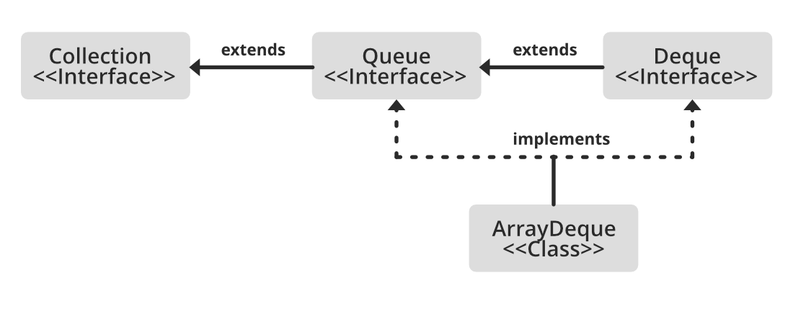

Slide 51
Array Deque implements : Queue and Deque.
It is dynamically resizable from both sides.
All implemented interfaces of Array Deque in the hierarchy are Serializable, Cloneable, Iterable<E>, Collection<E>,Deque<E>, Queue<E>.

Slide 52
Methods in Array Deque
add(Element e) - The method inserts a particular element at the end of the deque.
addFirst(Element e) - The method inserts particular element at the start of the deque.
addLast(Element e) - The method inserts a particular element at the end of the deque. It is similar to the add() method.
clear() - The method removes all deque elements.
element() - The method returns element at the head of the deque.
getFirst() - The method returns first element of the deque.
getLast() - The method returns last element of the deque.
peek() - The method returns head element without removing it.
remove() – The method returns head element and also removes it.

Slide 53
Syntax: Declaration
public class ArrayDeque<E>
extends AbstractCollection<E>
implements Deque<E>, Cloneable, Serializable
Here, E refers to the element which can refer to any class,
such as Integer or String class.

Slide 54
constructors
ArrayDeque()
ArrayDeque<E> dq = new ArrayDeque<E>();
ArrayDeque(Collection<? extends E> c)
ArrayDeque<E> dq = new ArrayDeque<E>(Collection col);
ArrayDeque(int numofElements)
ArrayDeque<E> dq = new ArrayDeque<E>(int numofElements);

Slide 55
various operations on the Array Deque
Adding operation
Accessing operation
Removing operations
Iterating through the Deque

Slide 56
Operation 1: Adding Elements
add()
addFirst()
addLast()
Offer()
offerFirst()
offerLast()

Slide 57
Operation 2: Accessing the Elements
getFirst()
getLast()
peek()
peekFirst()
peekLast()

Slide 58
Operation 3. Removing Elements
Remove from both the ends
remove()
removeFirst()
removeLast()
Apart from that
poll()
pollFirst()
pollLast()
pop()

Slide 59
Operation 4: Iterating through the Deque
remove()
iterator()
descendingIterator()

Slide 60
ARRAY DEQUE AS A STACK
To implement LIFO stacks in JAVA.
Faster
Methods for implementing stack.
push()-adds an element to the top of the stack.
Peek()-returns an element from the top of the stack.
Pop()-returns and removes an element from the top of the stack.

Slide 61
Thank you

